Slide 1


Module 2 – Designing the Data Map

Slide 2
The Purview Data Map
Microsoft Purview Tenant
Catalog and Data Estate Health
Governance Domain
Governance Domain
Critical Data Elements
Glossary Terms
Critical Data Elements
Glossary Terms
Data Product
Data Product
Data Product
Datasets
Dashboards/Reports
Models
Datasets
Dashboards/Reports
Models
Datasets
Dashboards/Reports
Models
Technical Domains are Previously Purview “Accounts” and each tenant may have up to 5 technical domains.
Data Map
Technical Domain
Technical Domain
Technical Domain
Collection
Collection
Collection
Collection
Notes:
Slides need work
Top-Level Overview
"This entire diagram represents the Microsoft Purview Tenant. Everything within it operates under a single logical governance and data estate health view.“
Catalog and Data Estate Health
"At the top level, we have the Catalog and Data Estate Health view. This is where Purview provides high-level insights across your data estate, enabling better decision-making.“
Governance Domains
"Within the tenant, we define Governance Domains. These can be our business-aligned areas of responsibility, such as HR, Finance, or Marketing. Each domain contains its own:
Critical Data Elements, which are the key data items necessary for business operations.
Glossary Terms, which define shared vocabulary used across the organisation.
And they're managed by Glossary Teams, ensuring the right people are maintaining these definitions.“
Data Products
"Inside each governance domain, we have Data Products. Think of these as curated, high-quality, reusable data assets. Each product includes:
Datasets, like tables or files,
Dashboards/Reports, which are our business insights,
And Models, such as powerbi semantic models.“
Data Map (Bottom Section)
"At the foundation of this structure is the Data Map, where the technical implementation resides. This is where you integrate with actual data sources."
Technical Domains
"Each tenant can have up to 5 Technical Domains, which were previously known as 'Purview Accounts'. These are typically aligned to platform teams or IT units and consist of one or more Collections, which represent groups of scanned assets."
"Technical domains power the governance domains by surfacing metadata from source systems. So, governance is layered on top of the technical structure."
Closing summary:
In essence, this model shifts governance from a tech-only focus to a business-aligned structure that reflects how your organisation actually operates—while still retaining tight integration with the underlying technical estate.
And with the addition of the Unified Data Catalog, we're now seeing a shift toward data mesh-like governance—where domains own and manage their own data products, and data is treated more like a product than just an asset.
END
In Microsoft Purview, technical and business domains interact to create a comprehensive data governance framework that aligns both technical infrastructure and business processes.
Technical domains focus on the infrastructure and systems used to manage data. They include databases, data warehouses, data lakes, and ETL tools. These domains are managed by IT professionals and data engineers to ensure the technical infrastructure is robust and secure.
Governance domains, on the other hand, align with the organisational structure and business processes. They focus on the context and usage of data within specific business areas or functions, such as finance, human resources, sales and marketing, and operations. Business domains are managed by business analysts and domain experts to ensure data is organised in a way that is meaningful to business users
The interaction between these domains is crucial for effective data governance. Here are some ways they interact:
Data Integration: Technical domains provide the infrastructure for data storage and processing, while business domains define the context and usage of this data. This ensures that data is not only stored securely but also used effectively to meet business needs.
Data Quality and Compliance: Technical domains handle the technical aspects of data quality and compliance, such as implementing data quality rules and ensuring data security. Business domains ensure that these technical measures align with business requirements and regulatory standards
Data Lineage and Metadata Management: Technical domains manage the technical metadata, such as data schemas and transformations. Business domains manage business metadata, such as data definitions and business rules. Together, they provide a complete view of data lineage and metadata, ensuring data is understood and trusted across the organisation
Collaboration and Communication: Effective communication between technical and business domains is essential for successful data governance. Regular meetings and workshops, like the ones you have been organising, help ensure that both technical and business perspectives are considered in data governance decisions
By integrating technical and business domains, Microsoft Purview helps organisations manage their data more effectively, ensuring both technical and business needs are met.

Slide 3
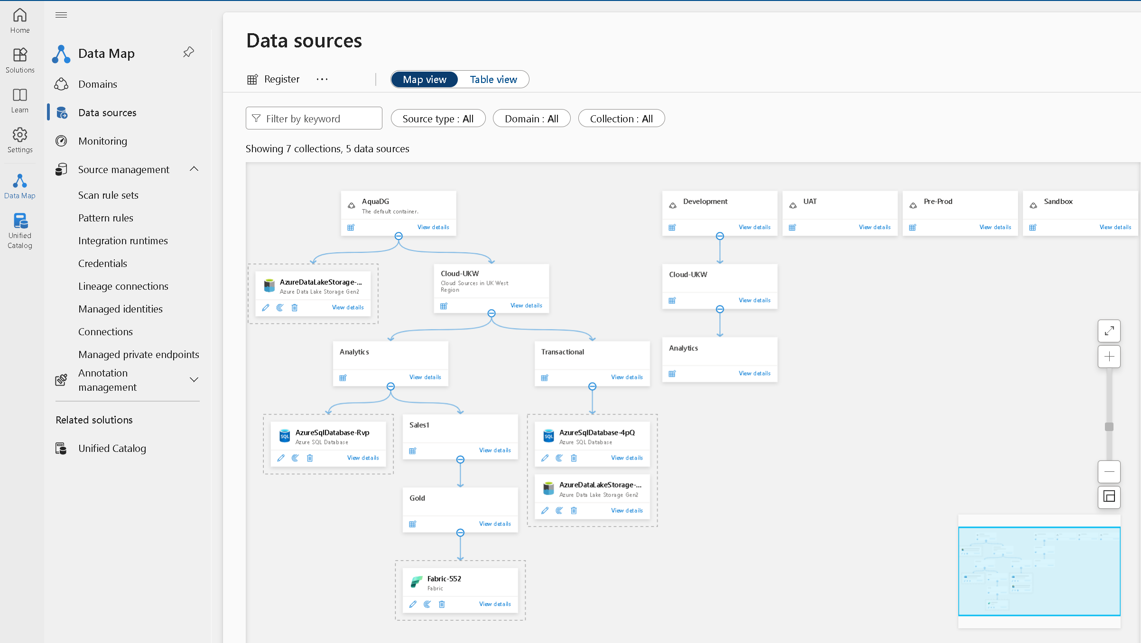
Purview Data Map – Structure, Domains & Collections

Slide 4
Purview Data Map Structure
Tenant level - Classifications, search, browse, metamodel, managed attributes, integration runtimes, lineage, workflows, insights, private endpoints.

Slide 5
Purview Data Map Structure
Domain level - Credentials, term templates, custom scan rule sets, advanced resource sets, pattern rules, policies, assets.

Slide 6
Purview Data Map Structure
Collection level - Data sources, scans, assets.

Slide 7
Microsoft Purview> DataMap > Collections
Technical Domains aka Platform Domains aka Root Collection
Domains are top-level hierarchies in Microsoft Purview, essential for the Data Map.
Domains will also serve as the container for collections, and assets.
In the Microsoft Purview Data Map, a domain is a construct that allows you to distribute organizational responsibility in your Microsoft Purview Data Map. Domains provide structure in your data map so domain administrators can maintain the isolation of collections, data sources, scans, and assigned roles for access control. Previously, only collections filled this role, but we're introducing domains as top-level nodes above the rest of the hierarchy to address a few other scenarios:
Decentralize and distribute responsibility by assigning roles at the domain level.
Create the possibility for hard logical separations within your Microsoft Purview Data Map.
Replace multiple accounts within a tenant to multiple domains within a single Microsoft Purview resource.
Every Microsoft Purview Data Map starts with a default domain. Up to 4 custom domains can be added.
Understand domains in the Microsoft Purview Data Map | Microsoft Learn

Slide 8
Microsoft Purview> DataMap > Collections
Technical Domains aka Platform Domains aka Root Collection
Domains are top-level hierarchies in Microsoft Purview, essential for the Data Map.
Segregation of Responsibilities:
Useful for organizations with subsidiaries or independent business units sharing a common Entra ID tenant.
Organization:
Group resources like data sources, assets, scans, and security resources by business unit or region.
Delegation:
Allow admins to delegate specific tasks within Microsoft Purview data governance to business units or suborganizations.
Security:
Implement targeted security measures and control access by isolating objects within domains.
Lifecycle Management:
Separate development, test, QA, preproduction, and production resources within the same tenant.
Isolation of Resources:
Isolate resources due to regional, legal, or regulatory requirements.

Slide 9
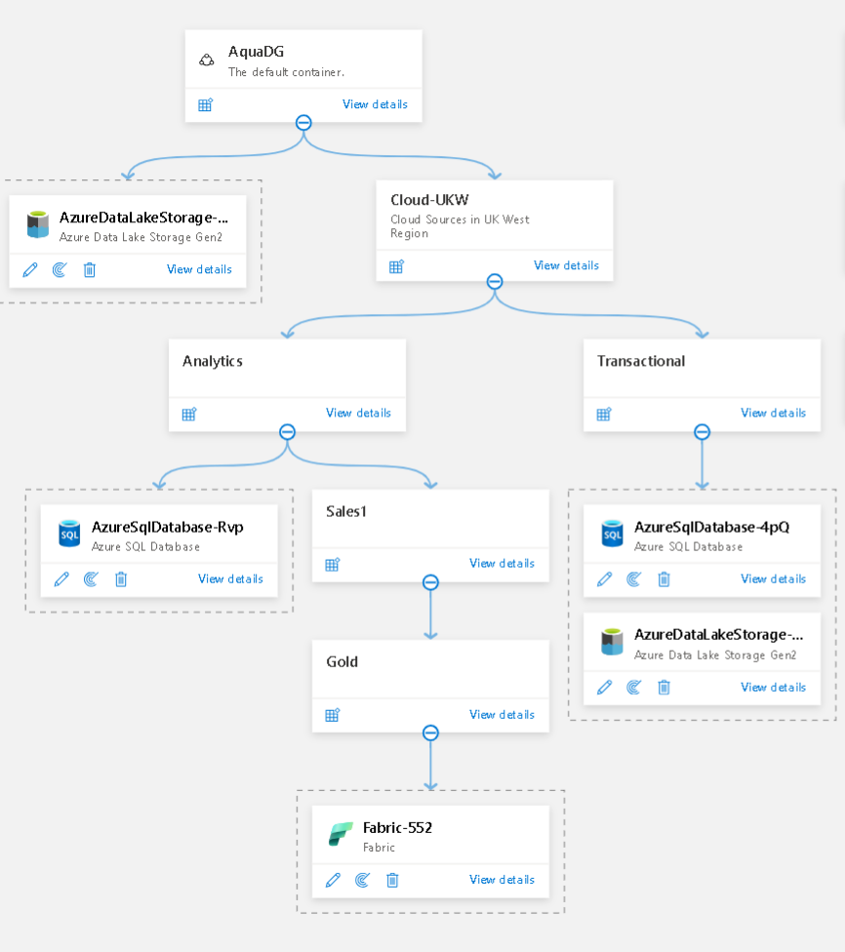
Microsoft Purview> DataMap > Collections
Collections
Organize assets and sources based on your business’ requirements, and restrict access to them using Purview Collections
Benefits
A collection is a tool Microsoft Purview uses to group assets, sources, and other artifacts into a hierarchy
Provide fine-grained access control
Discover assets by collection

Slide 10
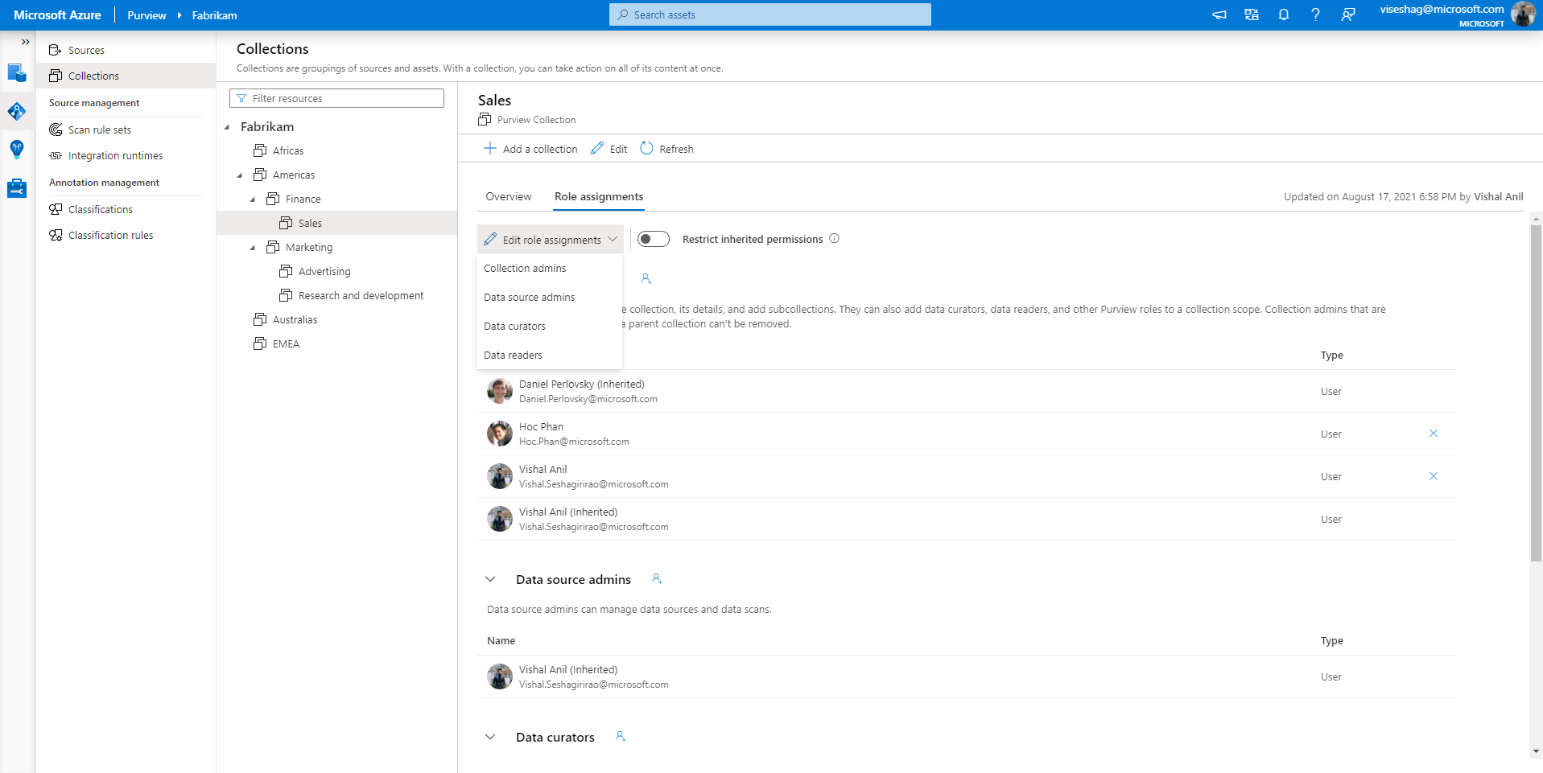
Microsoft Purview > DataMap> Collections
Collections – assigning roles
Assign Purview roles at the collection level to users, groups and service principals

Slide 11
Microsoft Purview > DataMap> Collections
Collections – assigning roles
Assign Purview roles at the collection level to users, groups and service principals

Slide 12
Microsoft Purview > DataMap> Collections
Collections – restricting access
Lock down certain collections of assets by restricting inherited permissions

Slide 13
Data Map Permissions
Name | Description
Domain admin | Can assign permissions within a domain and manage its resources. (domain level only)
Collection administrator | A role for users that will need to assign roles to other users in the Microsoft Purview governance portal or manage collections. Collection admins can add users to roles on collections where they're admins. They can also edit collections, their details, and add subcollections. A collection administrator on the root collection also automatically has permission to the Microsoft Purview governance portal. If your root collection administrator ever needs to be changed, you can follow the steps in the section below.
Data curators | A role that provides access to the data catalog to manage assets, configure custom classifications, create and manage glossary terms, and view data estate insights. Data curators can create, read, modify, move, and delete assets. They can also apply annotations to assets.
Data readers | A role that provides read only access to data assets, classifications, classification rules, collections and glossary terms.
Data source administrator | A role that allows a user to manage data sources and scans. If a user is granted only to Data source admin role on a given data source, they can run new scans using an existing scan rule. To create new scan rules, the user must be also granted as either Data reader or Data curator roles.
Insights reader | A role that provides read only access to insights reports for collections where the insights reader also has at least the Data reader role. For more information, see insights permissions.
Policy author | A role that allows a user to view, update, and delete Microsoft Purview policies through the Data policy app within Microsoft Purview.
Workflow administrator | A role that allows a user to access the workflow authoring page in the Microsoft Purview governance portal and publish workflows on collections where they have access permissions. Workflow administrator only has access to authoring, and so will need at least Data reader permission on a collection to be able to access the Purview governance portal.
Tenant
Data Map
Catalog
Technical Domain
Business Domain
Data Estate Health
Collections
Data Product
Data Sources
Workflows

Slide 14



Collection structure considerations
Domains are more strategic and policy-centric, while collections are more operational and access-centric.
Hierarchical Structure: Collections form a tree structure (one-to-many), allowing you to organize your resources into a hierarchy with access control boundaries.
Role Assignments: Collections support role assignments, allowing you to manage access and permissions at a granular level. These roles could include Domain admins, Collection admins, Data curators, and more.
Data sources can only be registered per tenant therefore needs separate data sources for dev/test/prod design.
Data sources are registered in one collection in one domain.
Inheritance: In Purview, permissions are inherited automatically from the parent collection to its sub collections. This inheritance is enabled by default and can be restricted/disabled as needed.
Platform Domains are limited to 5.
Collections are limited to 1000 across all platform domains. (One domain can have 1000 collections; 5 platform domains would have 200 collections each if spread evenly.)
Collections can be up to 8 levels deep (not including platform domain/root collection)
Assets from a scanned data source must be scanned in the same domain as the data source.
Microsoft Purview domains and collections architecture and best practices

Slide 15
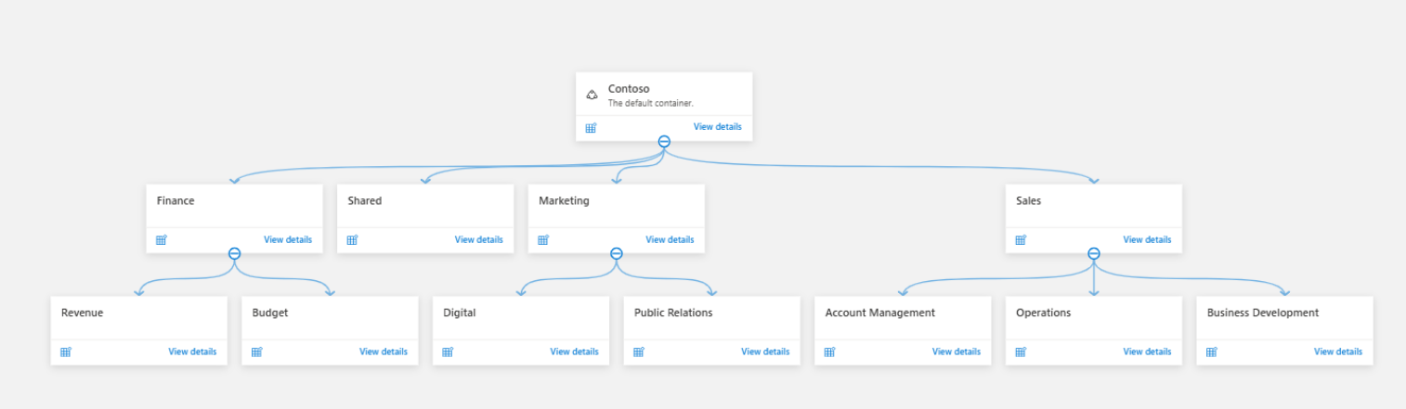
15
Domains and collections archetypes
Example 1: Single organization with a single environment and shared legal requirements
Notes:
This structure is suitable for organizations that:
Are based in a single geographic location and operate under same legal requirements.
Have a centralized data management and governance team where the next level of data management falls into departments, teams, or projects.
The hierarchy consists of these verticals:
Domains:
Default domain: Contoso
Collections under default domain:
Departments (a delegated collection for each department)
Teams or projects (further segregation based on projects)
There's no need for more domains, since there are no specific business or legal requirements to add more.
Organization-level shared data sources are registered and scanned in the root collection.
The department-level shared data sources are registered and scanned in the department collections.
Each data source is registered and scanned in its corresponding collection. So assets also appear in the same collection.

Slide 16
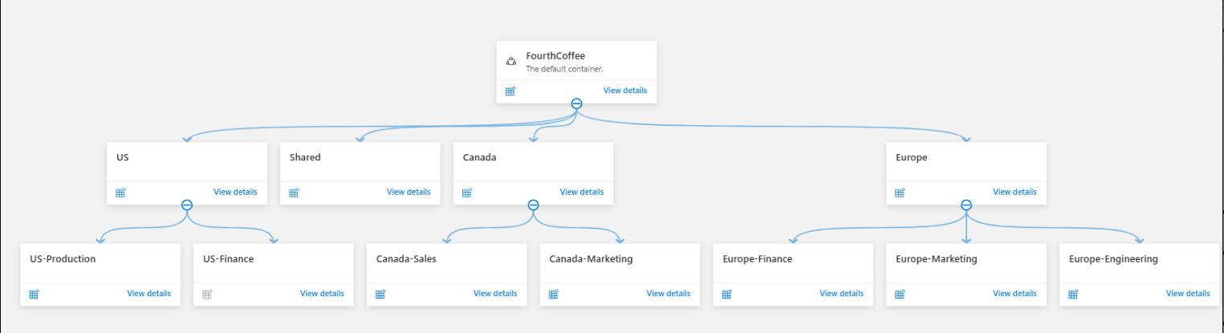
Example 2: Single multi-region organization with centralized management
Notes:
This scenario is useful for organizations:
That have presence in multiple regions.
Where the data governance team is centralized or decentralized in each region.
Where data management teams are distributed in each geographic location, and there's also a centralized federated management.
Teams that need to manage their own data sources and resources
The domain and collection hierarchy consists of these verticals:
Domains:
Default domain: FourthCoffee
Collections under default domain:
Geographic locations (top-level collections based on geographic locations where data sources and data owners are located)
Departments (a delegated collection for each department)
Teams or projects (further segregation based on projects)
In this scenario, each region has a collection of its own under the default domain in the Microsoft Purview account. Data sources are registered and scanned in the corresponding collections in their own geographic locations. So assets also appear in the collection hierarchy for the region.
If you have centralized data management and governance teams, you can grant them access from the default domain. When you do, they gain oversight for the entire data estate in the data map. Optionally, the centralized team can register and scan any shared data sources. The centralized team can also manage security resources such as credentials and integration runtimes.
Region-based data management and governance teams can obtain access from their corresponding collections.
The department-level shared data sources are registered and scanned in the department collections.

Slide 17
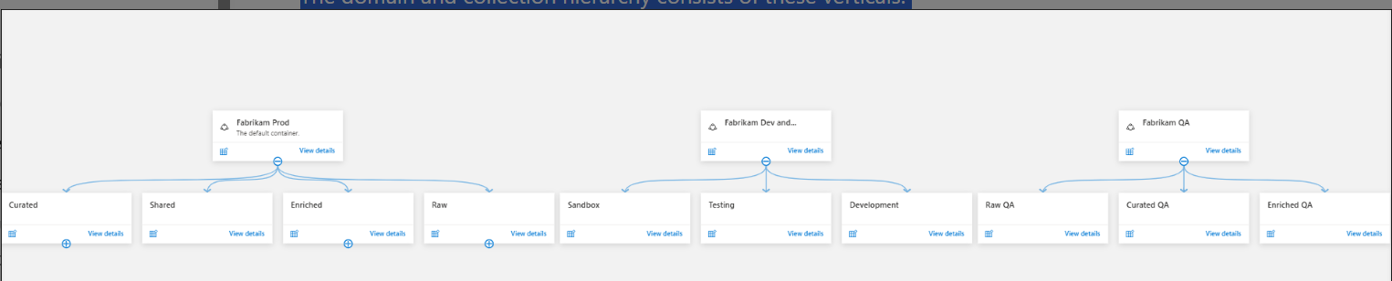
17
Example 3: Single organization with multiple environments
Notes:
his scenario can be useful if you have single tenant for all types of prod and non-prod environments and you need to isolate resources as much as possible. Data scientists and data engineers who can transform data to make it more meaningful, can manage Raw and Refine zones. They can then move the data into Produce or Curated zones in the corresponding environments.
The domain and collection hierarchy consists of these verticals:
Domains:
Default domain: Fabrikam production
Custom domain 1: Dev and Test
Custom domain 2: QA
Collections under each domain could follow any of these verticals:
Departments, Teams or projects (further segregation based on projects)
Data transformation stages (Raw, Enriched, Produce/Curated, Development, etc.)
Data scientists and data engineers can have the Data Curators role on their corresponding zones so they can curate metadata. Data Reader access to the curated zone can be granted to entire data personas and business users.

Slide 18
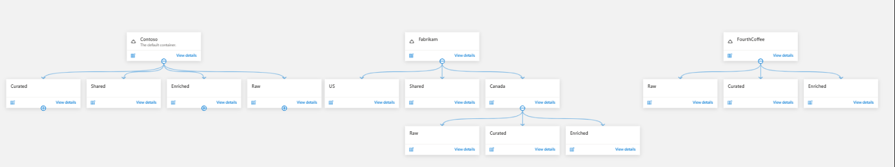
18
Example 4: Multiple organizations or companies, using the same Entra ID tenant with decentralized management
Notes:
This option can be used for scenarios where multiple companies share the same Entra ID tenant and each organization need to organize metadata and manage their own resources
Note
If you previously had multiple Microsoft Purview accounts in your tenant, the first account you select to migrate becomes default domain and you can upgrade the other accounts into separate domains.
The domain and collection hierarchy consists of these verticals:
Domains:
Default domain: parent company or organization such as Contoso
Custom domain 1: FourthCoffee
Custom domain 2: Fabrikam
Collections under each domain could follow any of these verticals:
Departments, teams or projects (further segregation based on projects)
Data transformation stages (Raw, Enriched, Produce/Curated, Development, etc.)
Regions within an organization
Each organization has a domain of its own with their own collections hierarchy in the Microsoft Purview account. Security resources are managed inside each domain and data sources are registered and scanned in the corresponding domains. Assets are added to the subcollection hierarchy for the specific domain.
If you have centralized data management and governance organization, that can be the default domain, so they can manage shared resources such as integration run-times, managed attributes, etc.
Organizational data management and governance teams can obtain access from their corresponding collections at a lower level, depending in centralized or decentralized management in each domain.

Slide 19
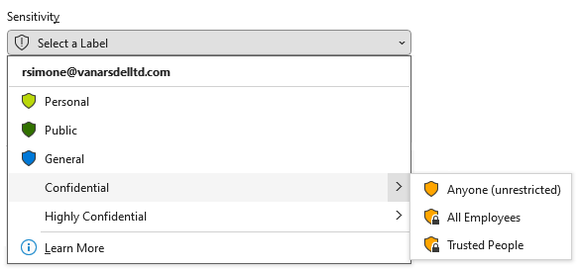
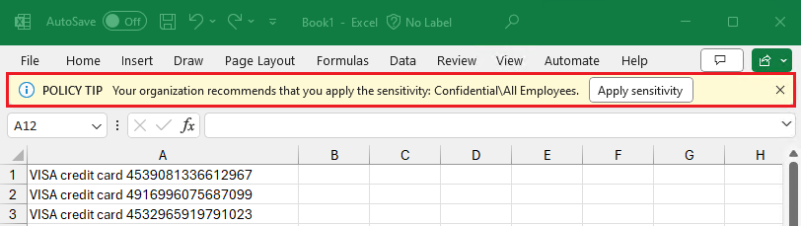
Understanding Sensitivity Labels
Classify and protect organizational data by 'stamping' the data
Follow the data no matter where it is stored
Created and maintained in Purview - Information Protection
Notes:
Sensitivity Labels are a feature that help you classify and protect organizational data (usually at the time of creation, but can be applied or modified at any time). They help ensure that user productivity and collaboration capabilities remain uncompromised by 'stamping' the data (file, folder etc) with a consistent text and protective properties that follow the data no matter where it is stored.
Sensitivity labels can be used to control access to content using encryption, add watermarks, and apply access policies automatically. This enables the consistent protection of content in Teams, SharePoint sites, chat and meeting data.
Sensitivity labels are created and maintained in Purview - Information Protection and extend to Power BI, the Purview Data Map, and even integrate with third-party applications. Supported data sources (see 'labeling' column).
The label's scope determines the label's settings and its availability to other apps and services. The label's order in the list also sets its priority (with labels appearing lower on the list having a higher order number and thus, higher priority).
Sub labels, or 'child' labels beneath a 'parent' label, present labels to users in logical groups. They do not inherit the protection settings of their parent label, but do inherit their colour.
Sensitivity labels are also recognized and used by Microsoft services like Microsoft Copilot for Microsoft 365 and Azure Information Protection, etc. These services check the usage rights for the individual user at runtime, enabling an extra layer of protection for labeled items.

Slide 20
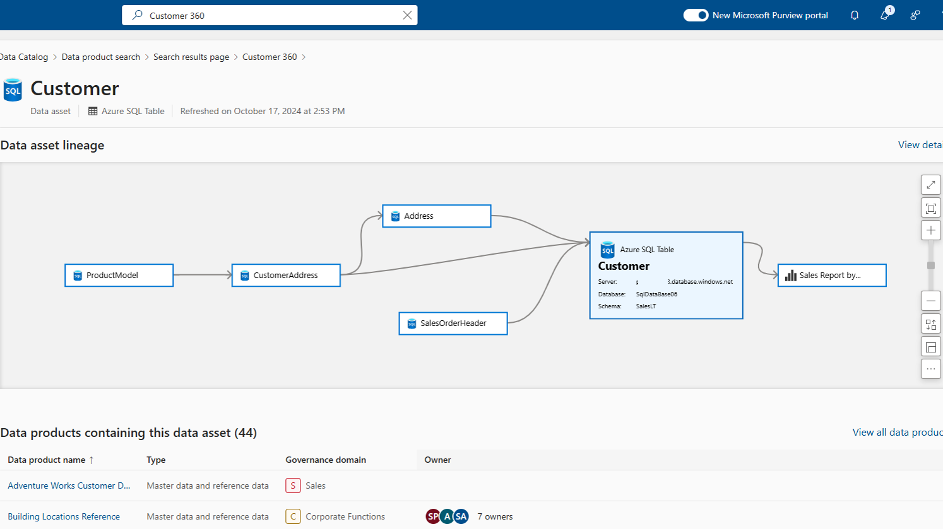
Understanding Data Lineage
Data Lineage represents the lifecycle of an organization's data
Is important for troubleshooting data pipelines, data quality analysis, compliance, and impact analysis
Types of Lineage:
Entity (or asset) Lineage
Column-level (or attribute) lineage
Notes:
Data Lineage represents the lifecycle of an organization's data, tracing its origin and movement across the data estate. This data could include raw data from various platforms, transformed and prepared data, and data utilized by visualization platforms.
Understanding the lineage of data assets is important for troubleshooting data pipelines, data quality analysis, compliance, and impact analysis. It illustrates how data moves from source to destination, including the transformations and business rules applied.
Types of Lineage:
Entity (or asset) Lineage: As the name suggested, this is lineage at the coarse grain of the entity or object level. Lineage is typically represented as a graph showing source and target entities, linked by a process invoked by a compute system, assisting in making the lineage human-readable.
Column-level (or attribute) lineage: This is lineage at a finer grain, i.e. columns within that entity. It identifies columns of a source entity that are used to create or derive columns in the target entity, assisting in tracking column-level changes from the source to the target.

Slide 21






Purview Collection Structure
For Discussion
Purview Tenant
Tenant Level
Account
Level
Prod Domain (default)
Dev/Test
Pre-Prod
Collection
Level
On Prem Operational
Cloud Operational
Cloud Analytical
Sub
Collection
Levels
A1
A2
A3
A4
A5
A6
DS1
DS2
DS3
DS4
DS5
DS6
21

Slide 22


For Discussion
Microsoft Purview Account & Collection Design Diagram (Current)
Tenant Level
Purview Tenant
Account
Level
Default platform domain
Classic Purview
Collection
Level
Eng Collection
BDG Collection
CDL Collection
Collection TBD
Sub
Collection
Levels
Appl. A1
Appl. A2
Appl. A3
Appl. A4
Appl. A5
Appl. A6
Appl. A7
Appl. A8
DS1
DS2
DS3
DS4
DS5
DS6
DS1
DS2

Slide 23
For Discussion
Microsoft Purview Domain Design Diagram (Future)
Purview Tenant
Tenant Level
Account
Level
Dev/Test Domain
Pre-Prod Domain
Prod Domain
Energy
Pre-Prod Domain
Energy
Prod Domain
Collection
Level
Eng Collection
BDG Collection
CDL Collection
Collection TBD
Collection TBD
Sub
Collection
Levels
Appl. A1
Appl. A2
Appl. A3
Appl. A4
Appl. A5
Appl. A6
Appl. A7
Appl. A8
Appl. A9
Appl. A10
DS1
DS2
DS3
DS4
DS5
DS6
DS7
DS8
DS9
DSN
In Scope

Slide 24
Module - 2
Lab time

